Slide 1
TEAM-8

Slide 2
FIRE: The Hot Disaster

Slide 3
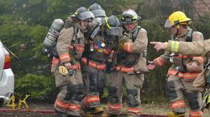
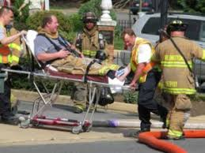
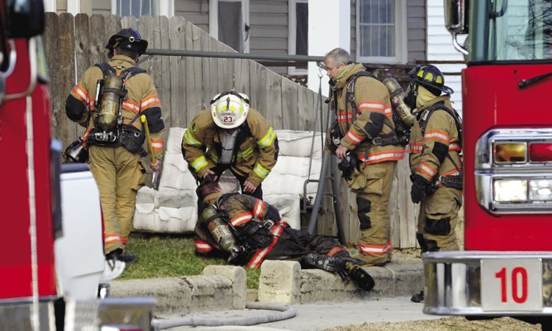
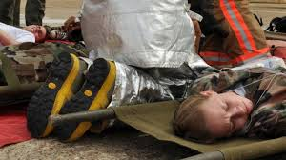
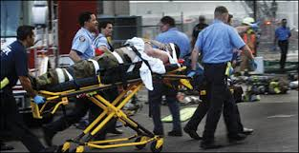
FIRE and FIREFIGHTERS

Slide 4


Slide 5
Costly
EXISTING SOLUTIONS
Bulky
No Human Aid
Lack of Communication Systems

Slide 6
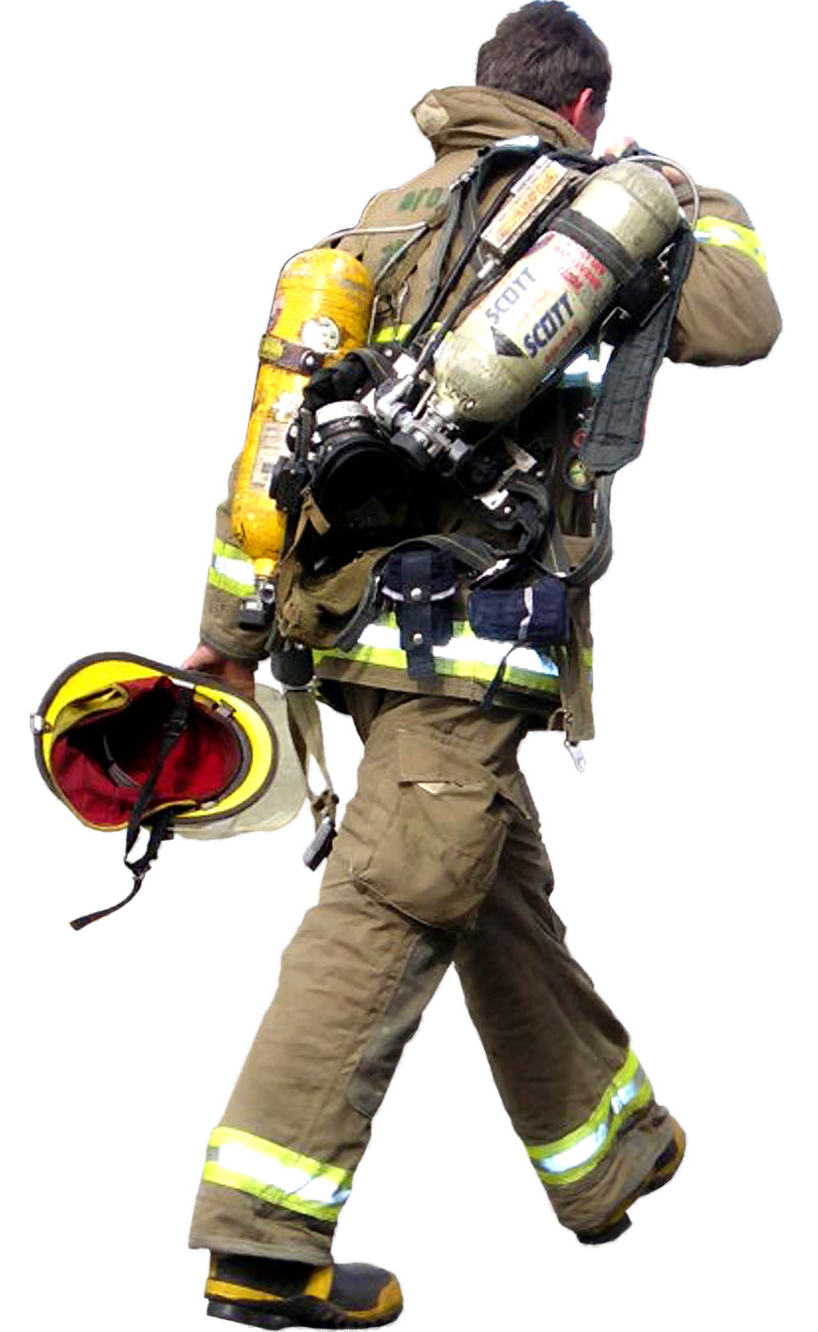

Slide 7
Semi
Autonomous
Fire
Fighting
Vehicle

Slide 8
SALIENT FEATURES

Slide 9
All Terrain Traversal
Fire Safety Equipment
SAFFV
Type A B C
Fire Treatment
Thermal
Imaging
Audio
Assistance
Wireless Control

Slide 10
MECHANICAL DESIGN

Slide 11
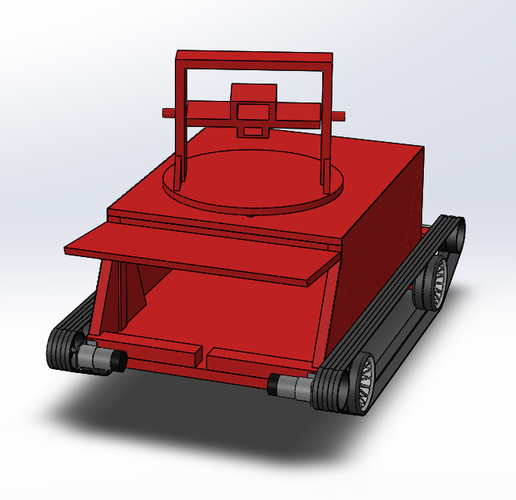
CHASSIS

Slide 12
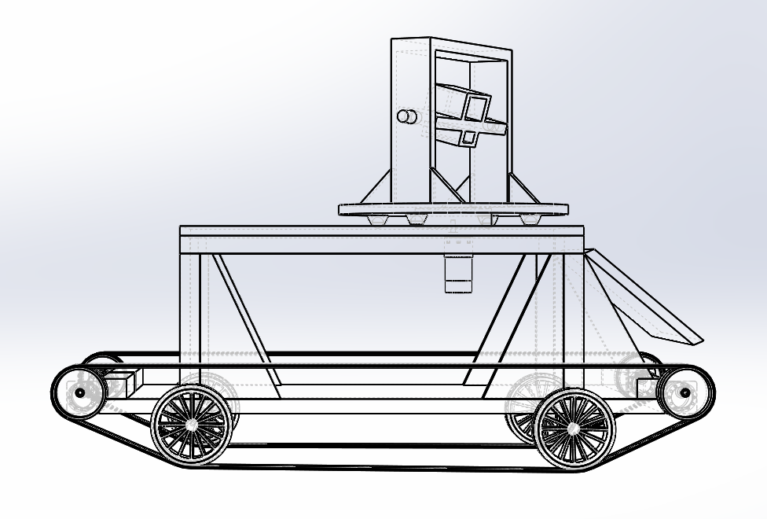
Structural Analysis

Slide 13
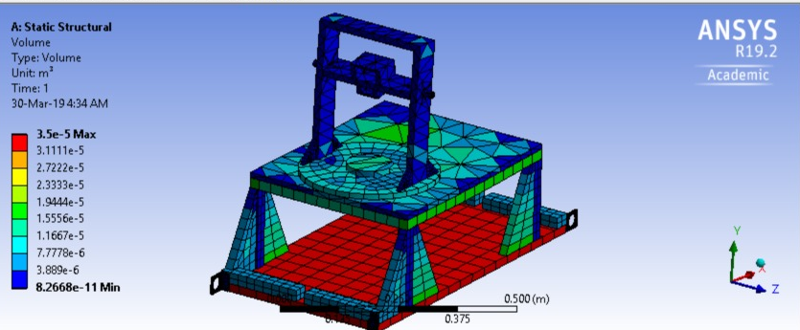

Slide 14
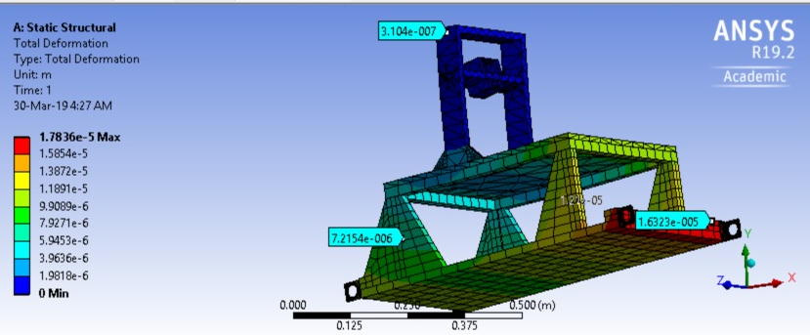

Slide 15
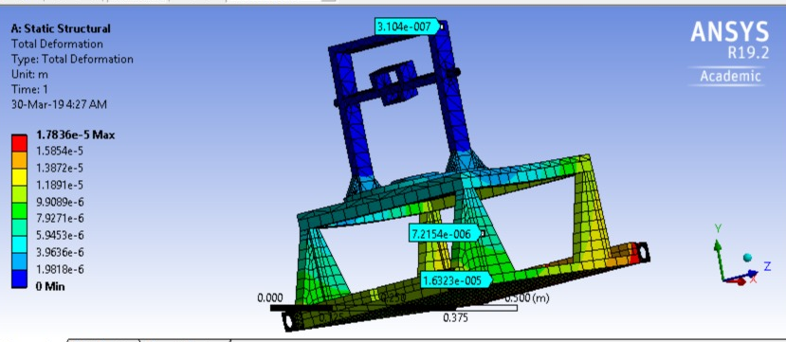

Slide 16
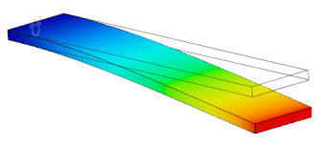
Thermal Analysis

Slide 17
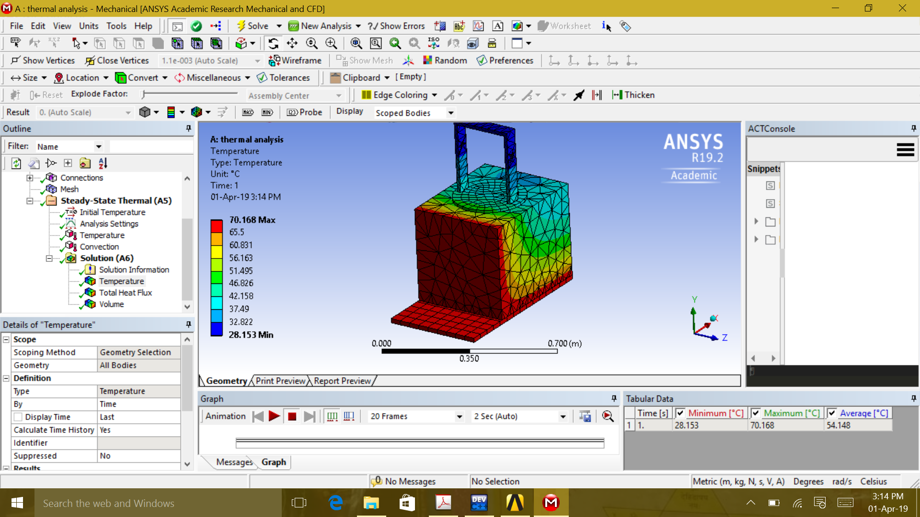

Slide 18
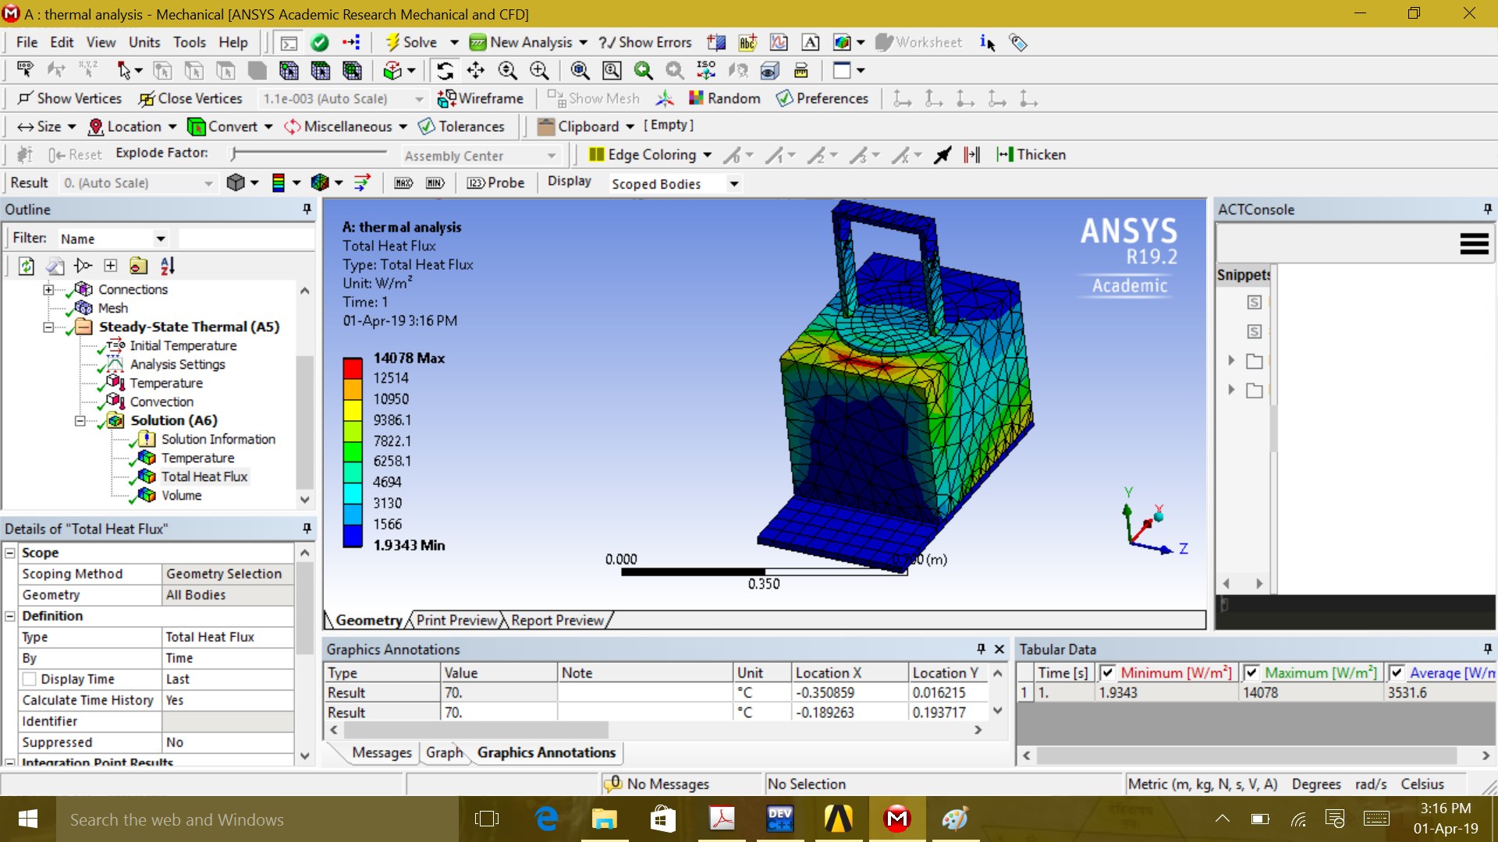

Slide 19
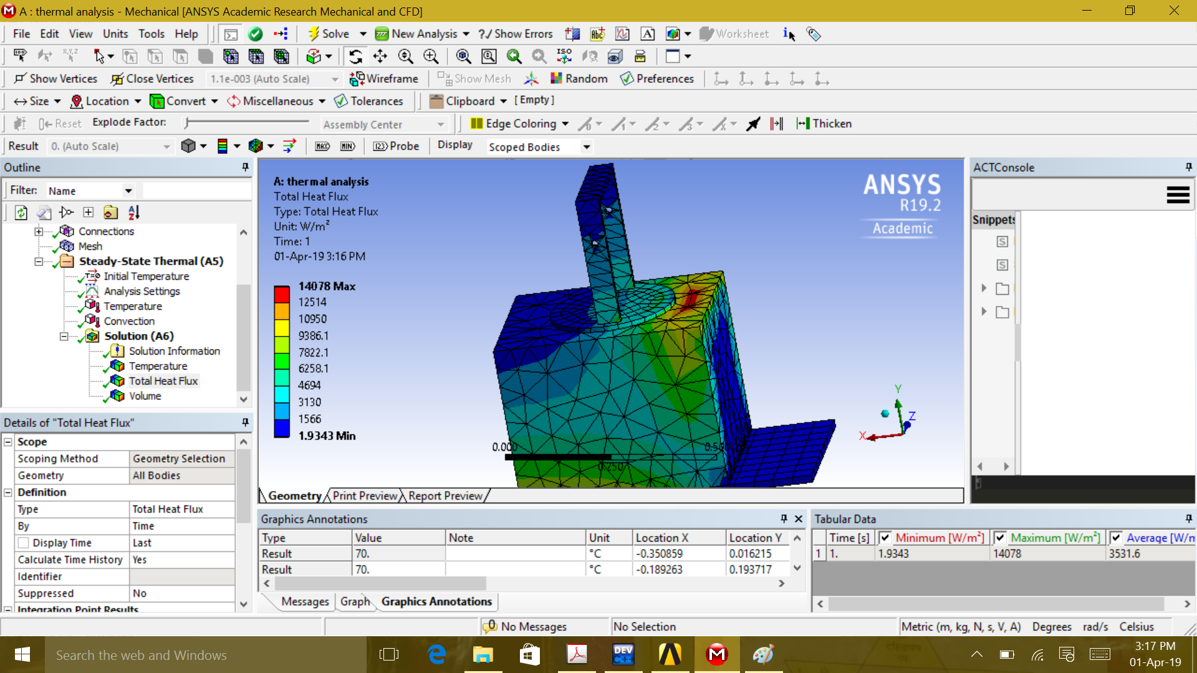

Slide 20
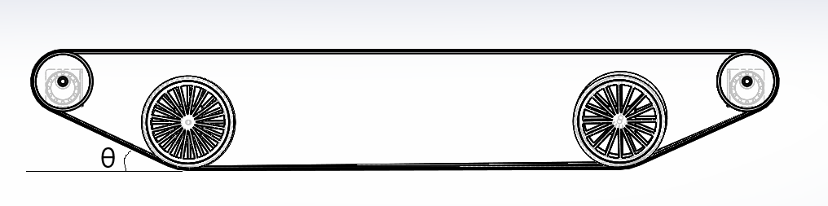
Drive Mechanism

Slide 21
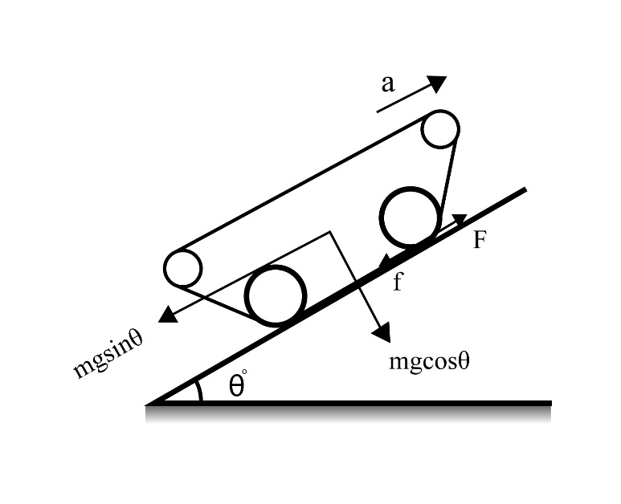
M=30 kg, a=0.1m/s² µ=0.33, Ɵ=20 ̊
F-f – mgsin20° = ma
f = μmgcos20° = 91.262 N
F = 194.91 N
T = 13.6443 Nm
T_{each wheel} = 3.41 Nm

Slide 22
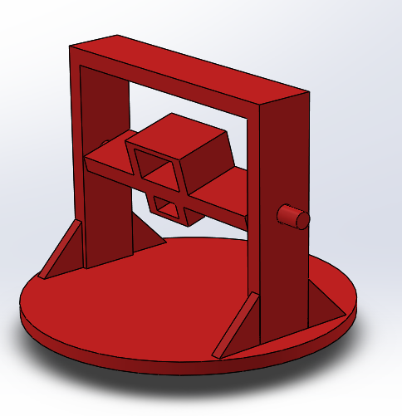
Rotating Platform And Fire Extinguishing Mechanism

Slide 23
ELECTRONIC AND SOFTWARE DESIGN

Slide 24
ELECTRONIC ARCHITECTURE:
12V Lead Battery
Motor Drivers
(12V)
5.6V
Regulated Supply
DC Powered Motors
Servo Motors, Speakers, Encoders
Arduino
Mega
Raspberry
Pi
PIR
Sensors
Webcam, IR, Camera, Microphone

Slide 25
COMMUNICATION
Angle and Velocity Command
Gas Sensor
Wireless Joystick
Gas and Smoke Level
Motion
Detection
Arduino Mega
PIR
Thermal
Imaging
Thermal IR Camera
Encoder
Rotating Platform Position
ROSSerial
Communication
Logitech C270
Video
@ 30 fps
Raspberry Pi 3B+
DC Motor Drivers
Velocity
Control
Speakers
Audio
Output
Servo
Motors
Angle
Control
Surrounding Audio
Input
USB mic
Client
Data Transmission at 5GHz

Slide 26
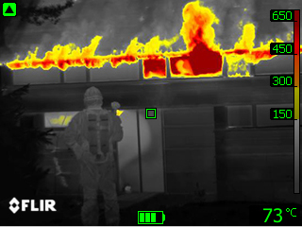
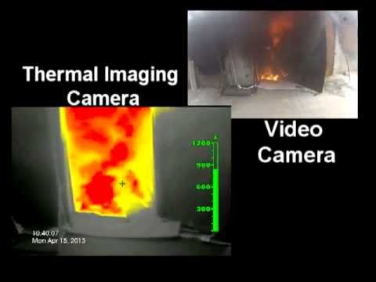
Thermal Imaging

Slide 27
COST ANALYSIS
Total Cost = 49925
Raspberry 3B+ | 2150
Arduino Mega 2560 | 850
Motors and Motor Drivers | 4350
Arduino Sensors | 370
Battery | 1800
FLIR Thermal | 20000
Web camera | 1500
Speakers, Mic and | 870
Mechanical Costs | 10385
Fire Extinguishing Equipment | 3500
Fire Safety Equipment | 1750
Other | 4153

Slide 28
FUTURE OF SAFFV
Stair Climbing Mechanism
Fully
Autonomous
Flame Detection by Normal Camera
Long Range Communication
Industrial & Residential Utilization

Slide 29
THANK YOU

